Slide 1
DATA ANALYSIS OF CONGENITAL HEART DISEASE USING ML

Slide 2
ABSTRACT:-
Too much cholesterol in your blood, however, puts you at increased risk of heart disease. High levels of cholesterol and other fatty substances can cause Atherosclerosis, a disease in which fatty plaques build up on blood vessel walls, restrict blood flow to the heart and can ultimately cause a heart attack. It occurs in almost 1% of births.
An approximate 100-200 deaths are due to unrecognized heart disease in newborns each year. These numbers exclude those dying before diagnosis.
Even though there are many methods and algorithms to predict the disease, not all of them are effective. We are going to see which algorithm is effective and predicts the precisive output in a short period of time.

Slide 3
UNDERSTANDING ABOUT THE DATA SET:-
We have data which classified if patients have heart disease or not according to features in it.
We will try to use this data to create a model which tries to predict if a patient has this disease or not. We will have many types of algorithms.

Slide 4
DATA SET:-

Slide 5
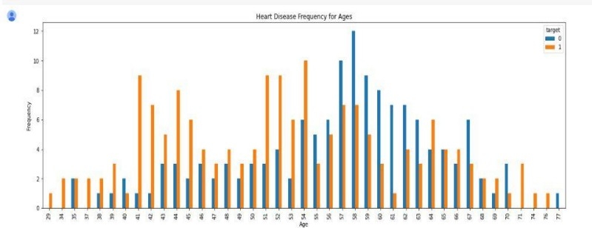
GRAPHICAL REPRESENTATION:-

Slide 6
ALGORITHMS USED:-
LOGISTIC REGRESSION
K-NEAREST NEIGHBOUR
SUPPORT VECTOR MACHINE
NAIVE BAYES
DECISION TREE
RANDOM FOREST CLASSIFIER

Slide 7
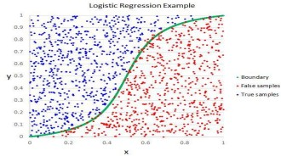
LOGISTIC REGRESSION:-
Logistic regression is the process of modeling the probability of the discrete outcome given an input variable.
Logistic regression is a useful analysis method for classiﬁcation problems, where you are trying to determine if a new sample ﬁts best into a category.

Slide 8
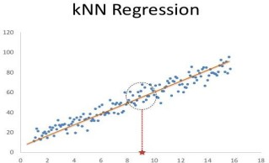
KNN:-
K-nearest neighbours (KNN) is a type of supervised learning algorithm used for both regression and classiﬁcation .
KNN tries to predict the correct class for the test data by calculating the distance between the test data and all the training points. Then select the K number of points which is closet to the test data.

Slide 9
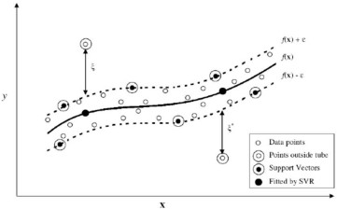
SUPPORT VECTOR MACHINE:-
Support vector machines (SVMs) are a set of supervised learning methods used for classiﬁcation, regression and outliers detection .
The advantages of support vector machines are: eﬀective in high dimensional spaces.
Still eﬀective in cases where number of dimensions is greater than the number of samples.

Slide 10
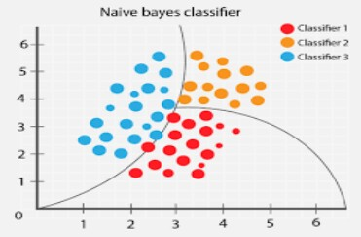
NAIVE BAYES:-
Naive Bayes classiﬁers are a collection of classiﬁcation algorithms based on Bayes' Theorem.
It is not a single algorithm but a family of algorithms where all of them share a common principle, i.e. every pair of features being classiﬁed is independent of each other.
It is Suitable for Binary and Multiclass Classiﬁcation.
It is used for Making Prediction based on Historical Results.

Slide 11
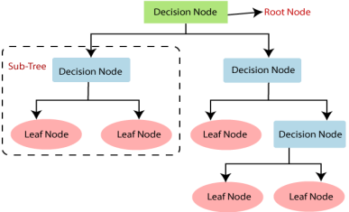
DECISION TREE:-
A decision tree is a flowchart-like structure in which each internal node represents a "test" on an attribute (e.g. whether a coin flip comes up heads or tails), each branch represents the outcome of the test, and each leaf node represents a class label (decision taken after computing all attributes).

Slide 12
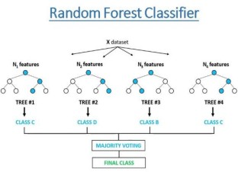
RANDOM FOREST CLASSIFIER:-
Algorithm that is used widely in Classiﬁcation and Regression problems.
It builds decision trees on diﬀerent samples and takes their majority vote for classiﬁcation and average in case of regression. It performs better results for classiﬁcation problems

Slide 13
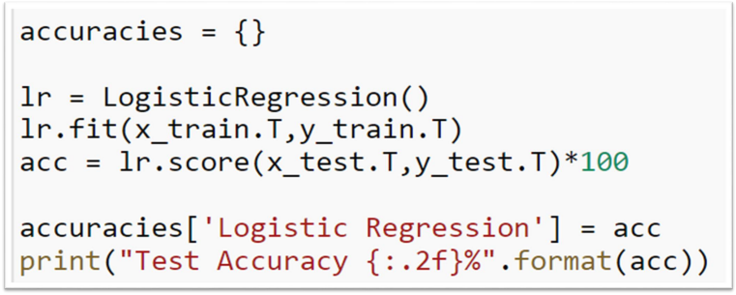
CODES:-
LOGISTIC REGRESSION:-

Slide 14
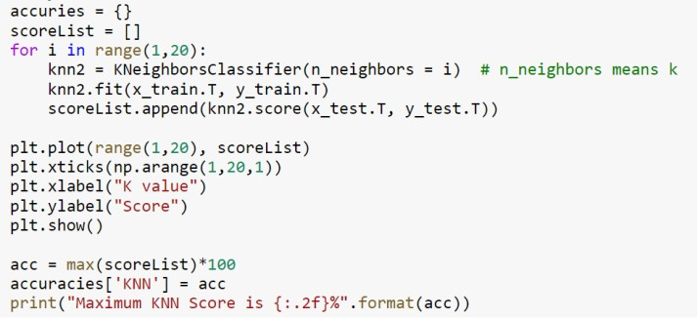
CODES:-
K-NEAREST NEIGHBOURS

Slide 15
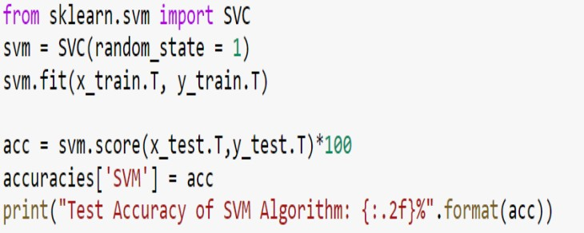
CODES:-
SUPPORT VECTOR MACHINE

Slide 16
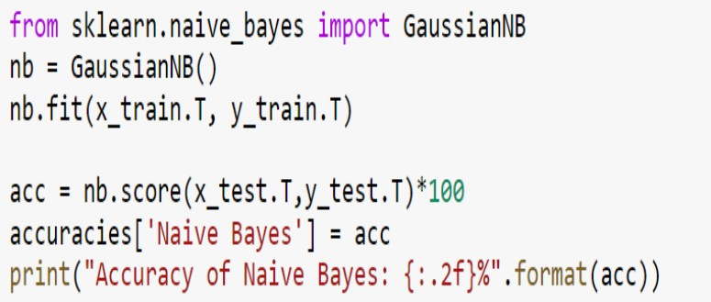
CODES:-
NAÏVE BAYES:-

Slide 17
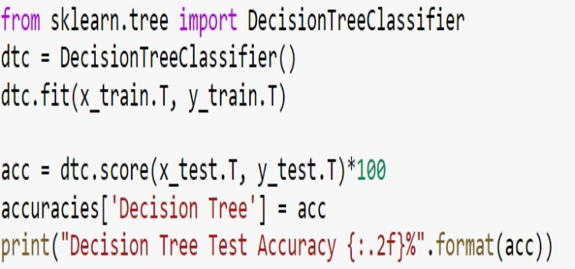
CODES:-
DECISION TREE:-

Slide 18
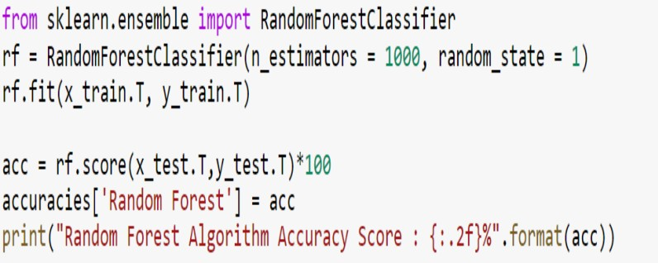
CODES:-
RANDOM FOREST CLASSIFIER:-

Slide 19
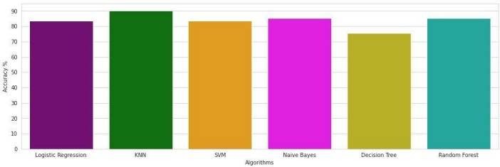
FLOW CHART FOR ACCURACY:-

Slide 20
RESULT:-

Slide 21
RESULT:-

Slide 22
CONCLUSION:-
So we can conclude that from the above algorithms KNN is more eﬀective and precise ,which can be used in prediction of heart disease.
As increased development in the medical ﬁeld and also the application of AI in the modern world, which decreases the death rate of victims, it can be even decreased by controlled diet and exercise.
Treating risk factors like hypertension, diabetes mellitus and high cholesterol will go a long way in prolonging life.

Slide 23
REFERENCE:-
https://www.kaggle.com/neisha/heart-disease-prediction-using-logistic regression
https://www.kaggle.com/code/cdabakoglu/heart-disease-classifications-machine-learning

Slide 24
THANK YOU…

